Slide 1

Zomato Analysis
P407
by Group 4

Slide 2

Introduction
ZOMATO Provide information and reviews on restaurants , including images of menus where the restaurant does not have its own website
ZOMATO is the best way or option to search and discover the places to eat

Slide 3
Business Problem
Zomato faces the challenge of optimizing its platform for user engagement and revenue growth in a highly competitive food delivery market. Key concerns include maintaining user retention, fostering strong relationships with restaurant partners, and ensuring service quality. Analyzing user data and market trends is crucial for Zomato to refine its strategies and sustain its position in the industry.

Slide 4




Scope
The scope of the Zomato analysis project encompasses collecting and analyzing user data, market trends, and operational metrics to optimize the platform's performance. It involves identifying key performance indicators (KPIs) such as user engagement, retention, and service quality, as well as developing strategies to address these metrics. Additionally, the project involves leveraging data analytics to refine marketing strategies, improve user experiences, and foster partnerships with restaurants. The ultimate goal is to drive revenue growth and maintain competitiveness in the dynamic online food delivery market.

Slide 5



Key Performance Indicators (KPI)

Slide 6
Excel Dashboard

Slide 7
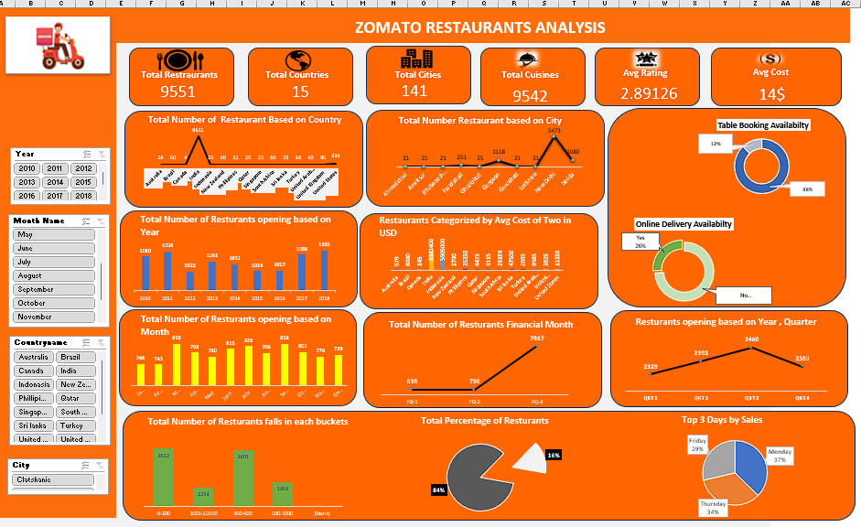

Slide 8
Tableau Dashboard

Slide 9
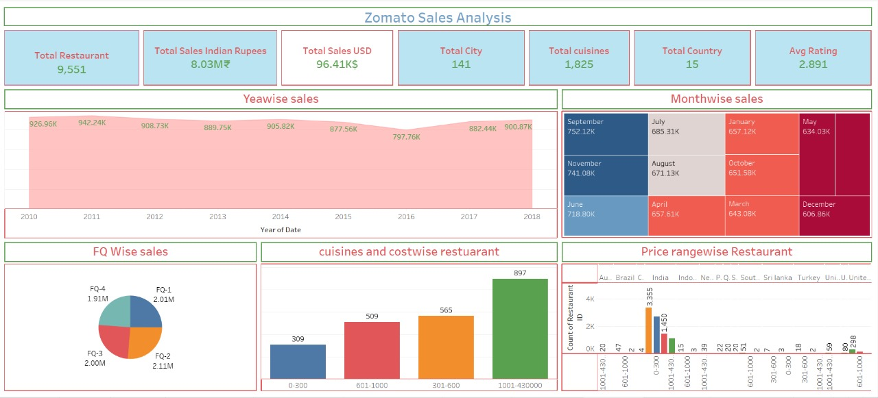

Slide 10
PowerBi Dashboard

Slide 11
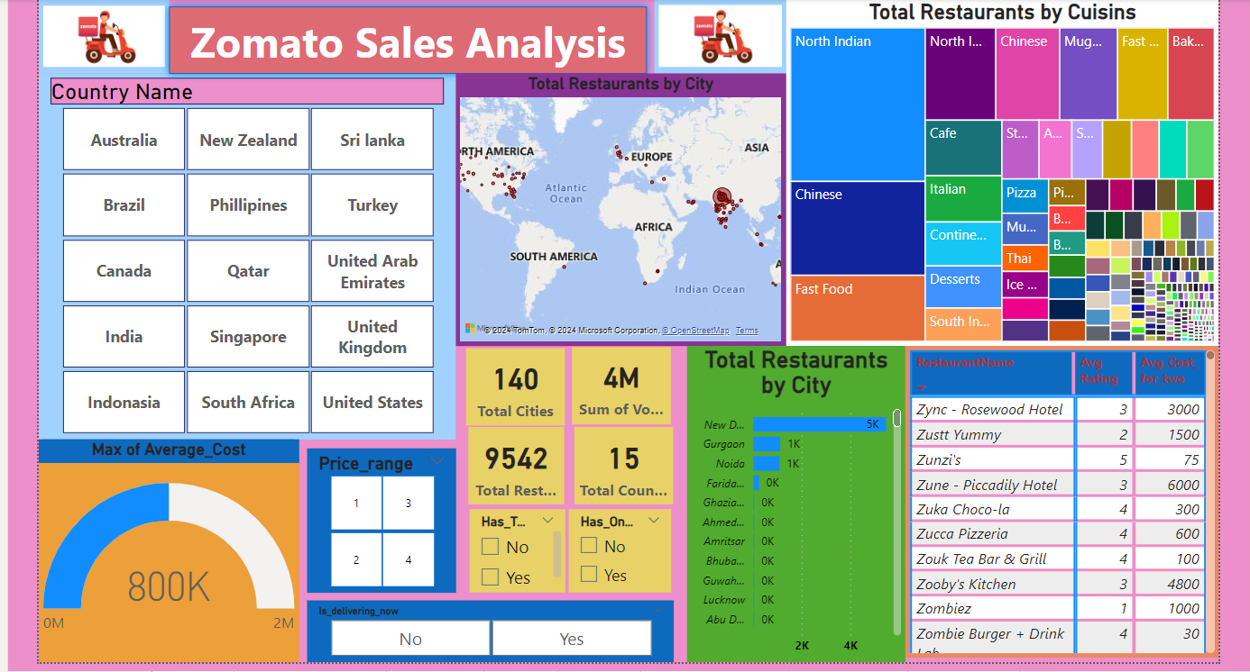

Slide 12



Challenges
Restaurants on Zomato platform are rejected food delivery orders.
Since Zomato is expanding drastically, they face challenges in different areas:
Geographic
Service-Based
Technology-Based

Slide 13

Suggestions
Integrate Zomato's data with relevant external datasets (e.g., economic indicators, population data) for deeper insights.
Implement predictive modeling techniques to forecast restaurant performance, demand, or customer preferences.
Incorporate geospatial data to analyze restaurant distribution, competition, and customer demographics.
Employ natural language processing (NLP) techniques to analyze user reviews for sentiment analysis, identifying popular dishes, or detecting trends.

Slide 14
Conclusion
In summary, the Zomato analysis project offers a strategic avenue for optimizing platform performance and driving growth in the competitive food delivery market. By focusing on key performance indicators (KPIs) such as user engagement, retention, and service quality, Zomato can refine strategies and enhance the user experience. Leveraging data analytics enables Zomato to identify market trends, personalize offerings, and strengthen partnerships, leading to sustained revenue growth and competitiveness. Through continuous analysis and strategic adaptation, Zomato can position itself as a leader, meeting evolving customer needs and ensuring long-term success.

Slide 15
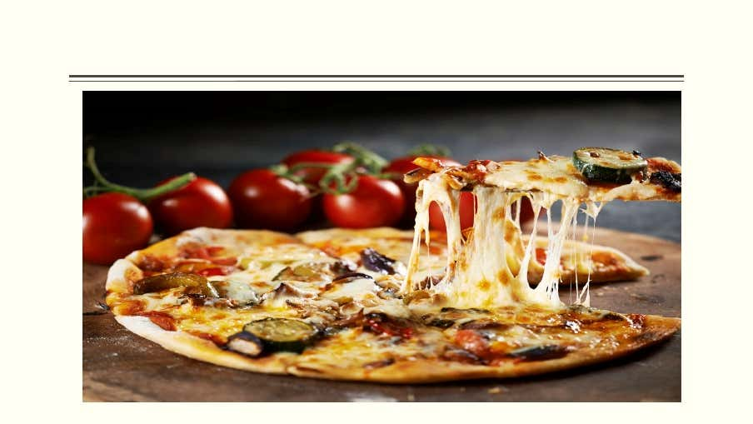
Thank you

